Slide 1
Power of Visualization
Submitted by:
Suthar Kaustubh
21BCE528

Slide 2
Contents
What is Visualization?
How Visualization works?
Why we need visualization?
What is Visualization?

Slide 3
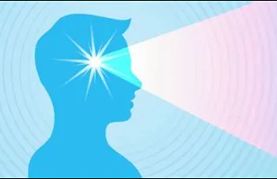
What is Visualization?

Slide 4

What is Visualization?
A Picture is worth a thousand words.
Thoughts become Reality.

Slide 5
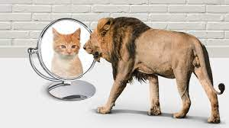
The effect can be in reverse too.

Slide 6
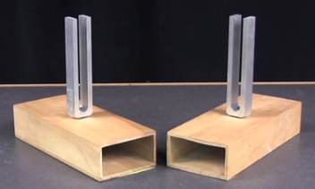
How Visualization works?
Visualization work by using principle of resonance.
Two identical tuning forks and sounding boxes are placed next to one another.
Striking one tuning fork will cause the other to resonate at the same frequency.
When a weight is attached to one tuning fork, they are no longer identical. Thus, one will not cause the other to resonate.

Slide 7
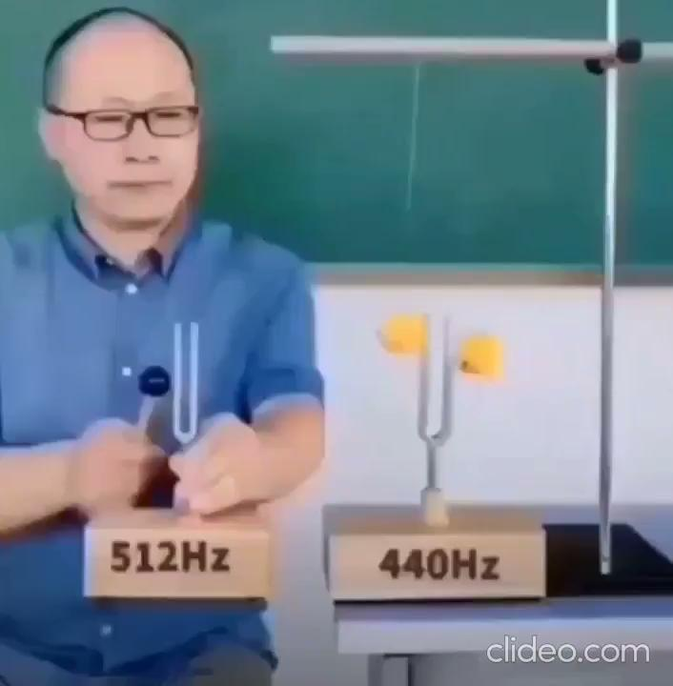

Slide 8
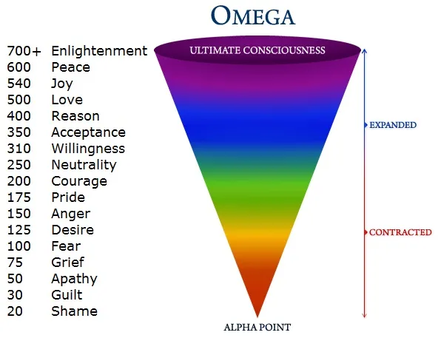
How Visualization works?

Slide 9
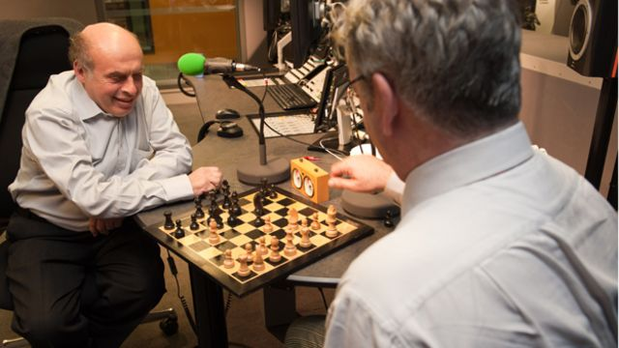
Why we need Visualization?
Natan Sharansky - a russian jew living In communist russia.
He was accused of being american Spy, and thrown into siberian jail.
Through visualization he beat a World champion chess player in mind while in jail.
And after that he also beat the chess champion in real world also.

Slide 10
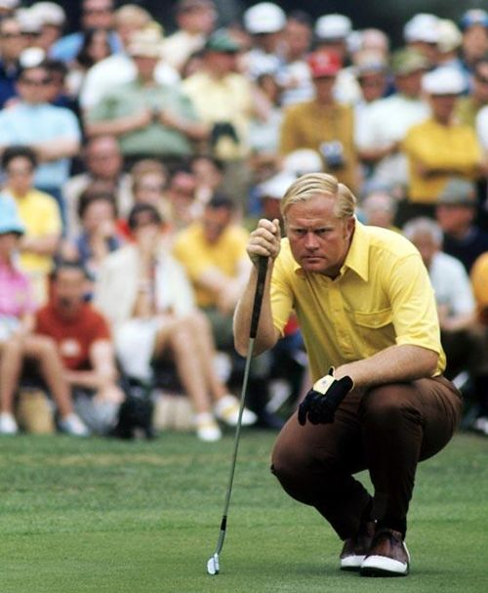
Why we need Visualization?
The number one golfer in american history has been Jack nicklaus.
He says “I never hit the ball before proper visualizing the whole terrain and the track and the ball in flight from the club & flying through the air and rolling into hole”.

Slide 11

Why we need Visualization?
Norman Cousins(A philosopher) used it to heal himself .
He was diagnosed with leukemia, blood cancer.
He describes his meditation that he daily meditate that millions upon millions WBCs in his blood, going & attacking these cancer cells and eating them up & finishing them up.
So, He live next 20 years successfully by using “The Power of Visualization”.

Slide 12
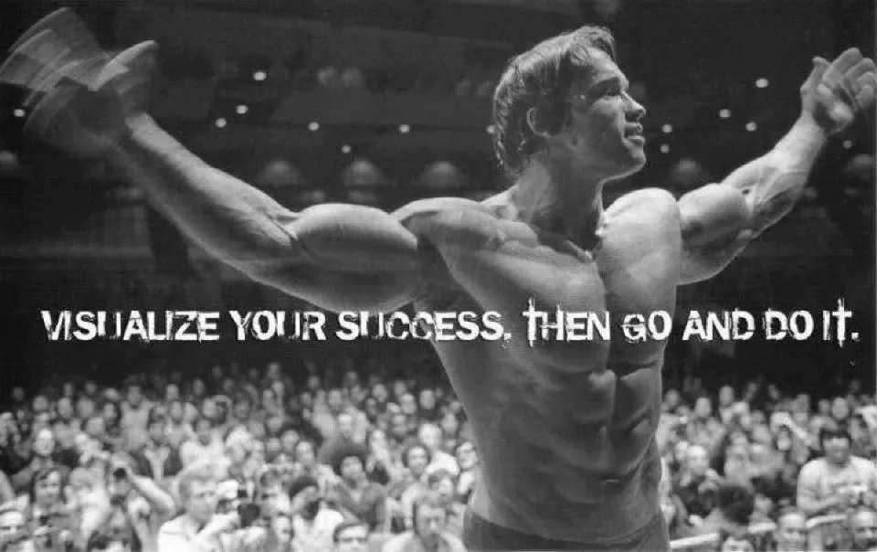
Why we need Visualization?
Arnold schwarzenegger was also a big believer in visualizing how he wanted to look like and kept on imagining it.
A study published in Neuropsychologia found that imagining to move certain parts of your bodies almost trains the muscle as much as the actual movement.

Slide 13
The END…
or is it a NEW Beginning…

